Slide 1
PROJECT RAPTORS REBOUND
DAT 205 Capstone Interim Progress
Group 1 - Bhavika Patil, Cindy Guo, Dennis Hung
Notes:
Good evening Everyone,
Today, we Group 1; Myself – Bhavika, Cindy and Dennis are going to present the progress we have made on our Project RAPTORS REBOUND
[NEXT SLIDE]

Slide 2
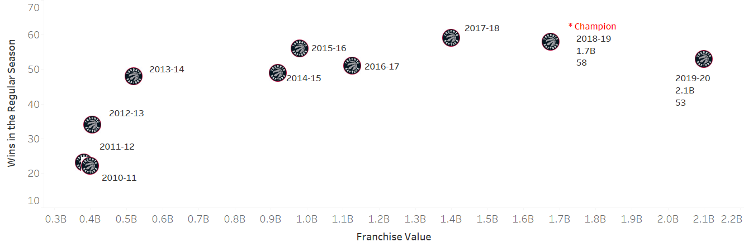
The Client
The Toronto Raptors are an NBA championship team with a USD2.1 billion market capitalization in 2020.
The team’s General Manager (GM) and owners are seeking recommendations on improving the team’s chances at another championship run while preserving the team’s long-term future.
TORONTO RAPTORS
Notes:
The Client
[NEXT 01 – Graph]
The Toronto Raptors (TOR) is an NBA championship team with a $2.5 billion market capitalization. The franchise added key players in 2019 who contributed to critical wins during the season and championship playoff run. The team won their first-ever championship title in that season. The team’s performance has been in decline since being crowned 2019 NBA champions.
The team’s General Manager (GM) and owners are seeking recommendations on improving the team’s chances at another championship run while preserving the team’s long-term future. The recommendations will be in the form of marginal/minor improvements to the player roster. The stakeholders intend to either maintain or improve on the number of wins during the regular season and more importantly, during the playoffs.
The organization wants to retain a public interest in the team while improving the team’s performance without rebuilding the entire team. A spot in the NBA finals while maintaining the number of regular-season wins would be ideal.
[NEXT SLIDE]

Slide 3
Objectives
The primary objective of this analysis is to determine which features are important to the Toronto Raptors team to produce more wins in the regular season and the playoffs.
The secondary objective is to review team players’ performance-to-cost effectiveness.
Focus on the historical player data from 2005 to 2020 as this closely represent the players of the current era.
Notes:
To attain the requirements outlined by the management, we have set 2 objectives. we are looking to determine what features affect team wins/losses and predict how they can be improved/reduced through changes in the team’s roster.
1. The primary objective of this analysis is to determine which features are important to the Toronto Raptors team to produce more wins in the regular season and the playoffs.
2. The secondary objective is to review team players’ performance-to-cost effectiveness.
The scope of this analysis will be to focus on the historical player data from 2005 to 2020 as this closely represents the players of the current era. The performance baseline of the team and players will be established using the data for the Toronto Raptors 2019-2020 season. These statistics will be used to indicate performance features for the team and the individual players.
To simplify the analysis, the following assumptions were made:
Changes are only applied to the Toronto Raptors; the statistics from other teams are not affected or changed.
Obtaining any players is up to the Toronto GM to determine if they will pursue the player via free agency, trading of players, etc.
[NEXT SLIDE]

Slide 4
Project Team
Team Roles
Project Manager
Data Scientist
Programming Architect
Team communications
Schedule meetings (3+ times per week)
MS Teams, WhatsApp, email
Git and Google Drive
Notes:
[NEXT 01 – Team]
Our team was a very loose form of Scrum Agile. Everyone had input in each part. If we need to designate roles we defined it as
[NEXT 02, 03, 04 – Roles]
Project Manager where I (Dennis) handled scheduling and administrative duties
Data Scientist where Cindy’s role is help understand the data and some initial trends
Programming Architect where Bhavika’s role is taking care of our business unit’s division of coders (group 1)
[NEXT 05 – Communications]
We had multiple methods to facilitate team communications
[NEXT 06 – Meetings]
We had scheduled meetings 3 times per week to align on
what each of us had done
what we will do next
discuss challenges, next steps, and shared knowledge
[NEXT 07 – Tools]
Used various tools (MS Teams, WhatsApp) to contact each other for redundancy
[NEXT 08 – Repositories]
Use repositories such as Git and Google Drive to retain useful information, meeting minutes , techniques, and ideas for future reference.
This agreed upon structure helped facilitate our team relationships to work effectively and especially share knowledge since only 1 of us had specific understanding of the subject.
[Next speak handoff statement]
Now I shall hand off to Cindy
[NEXT SLIDE]

Slide 5
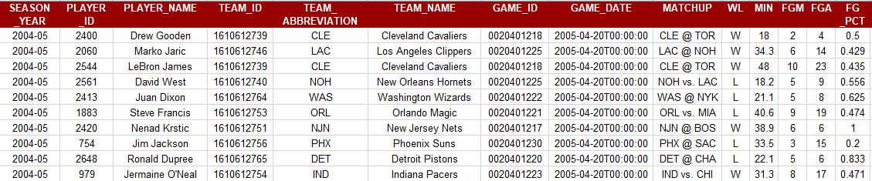
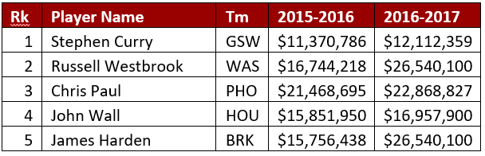
Data
Example PlayerGameLogs data subset
Example NBA Salary data subset
Notes:
Show examples of data we have.as a visual
The data collection for this analysis was a cumbersome process. We have used multiple sources to gather the data.
[NEXT 01 – API]
nba_api is an open access API client library for Python requesting the data via webservices through stats.nba.com. We are using 2 endpoints.
[NEXT 02 – Player Game Logs]
playgamelogs fetches player statistics for each game. This dataset consists of more than 450k rows. We are using 36 features. It has 15K records for the Toronto Raptors alone. We are only showing a few features here, this dataset acts as the main datasource for the analysis.
[
[NEXT 04 – Player salaries]
NBA webservice does not provide the salary data. Historical salary data was drawn from ESPN website and the future salary data from HoopsHype website. These were obtained using web scraping in python. We are looking at current 489 NBA players. We can relate this table to the Playergamelogs using the Player name and the Season year.
[Next speaker handoff statement]
Now I shall hand over to
[NEXT SLIDE]

Slide 6
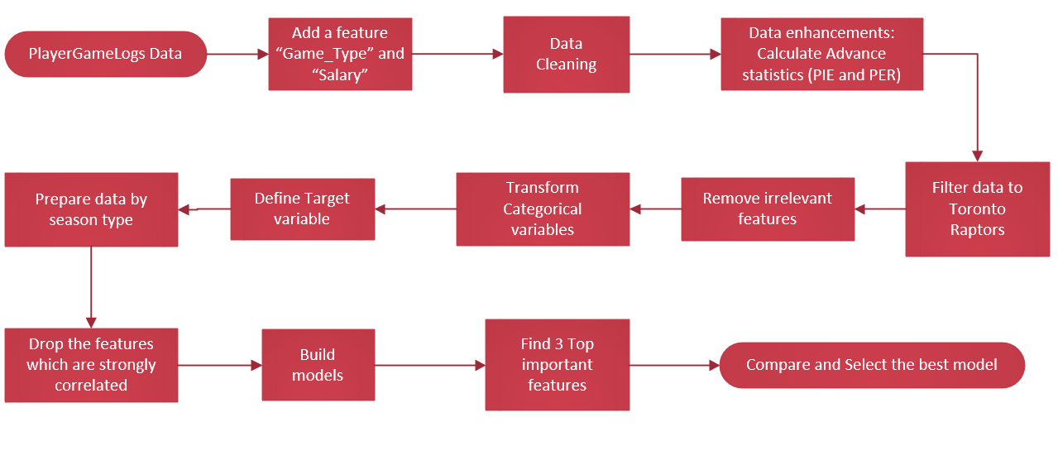
Data Preparation and Analysis
Phase 1: Feature Selection
Notes:
Talk and move through the boxes but in groupings (ie boxing the transformation
[NEXT SLIDE]

Slide 7
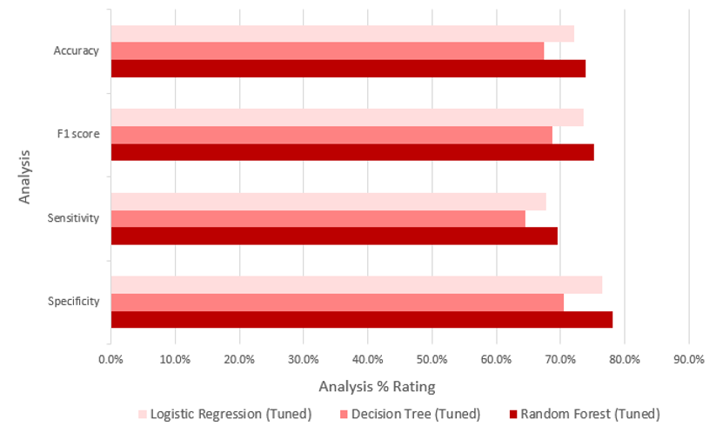
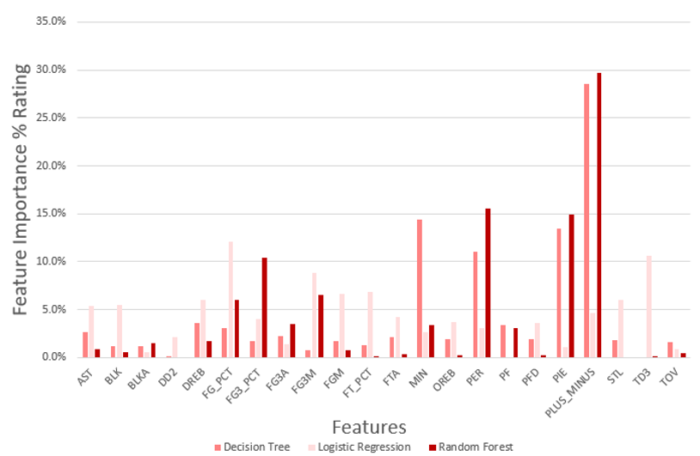
Data Preparation and Analysis
Notes:
[
[NEXT SLIDE]

Slide 8
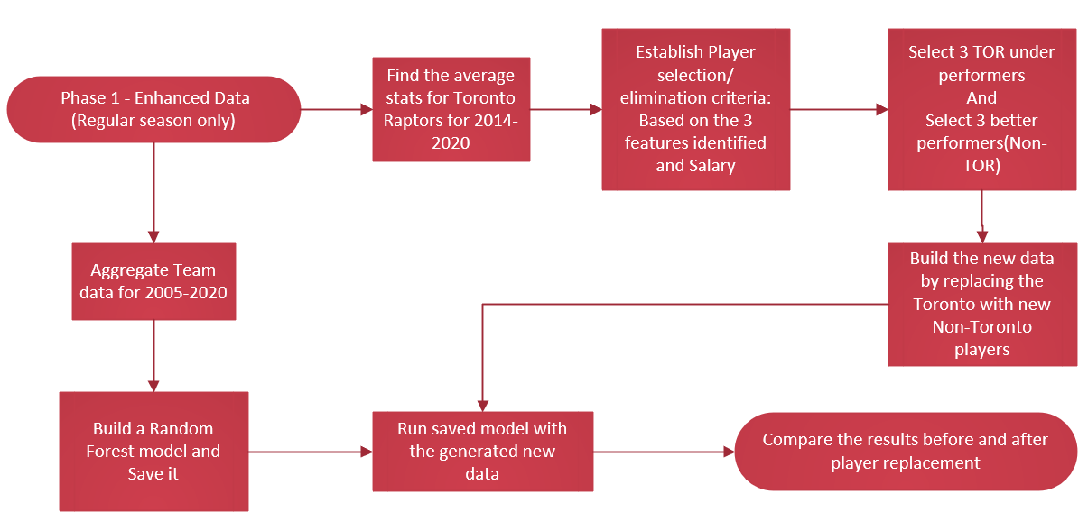
Data Preparation and Analysis
PHASE 2: PLAYER SELECTION
Notes:
[NEXT SLIDE]

Slide 9
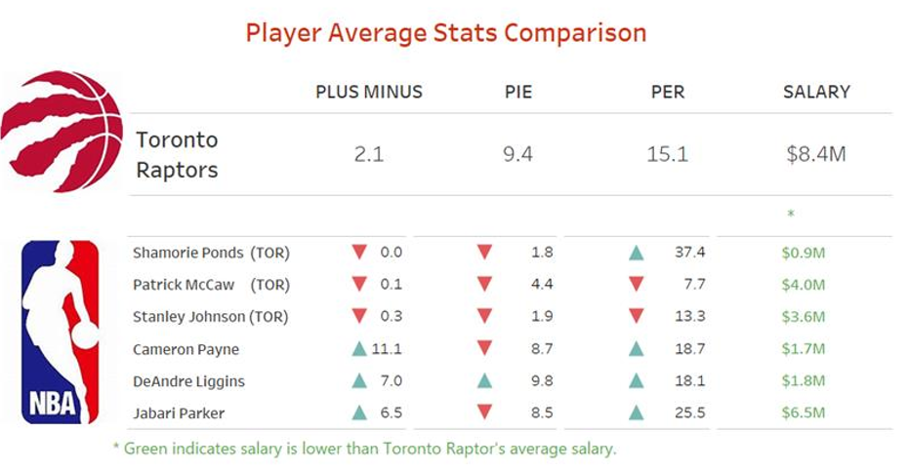
Data Preparation and Analysis
Notes:
[NEXT SLIDE]

Slide 10
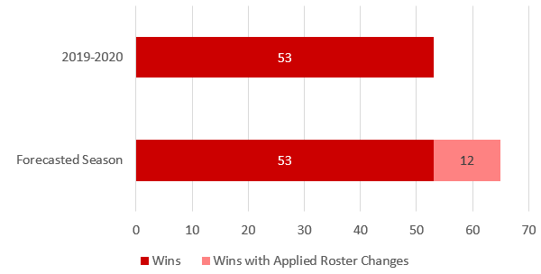
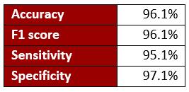
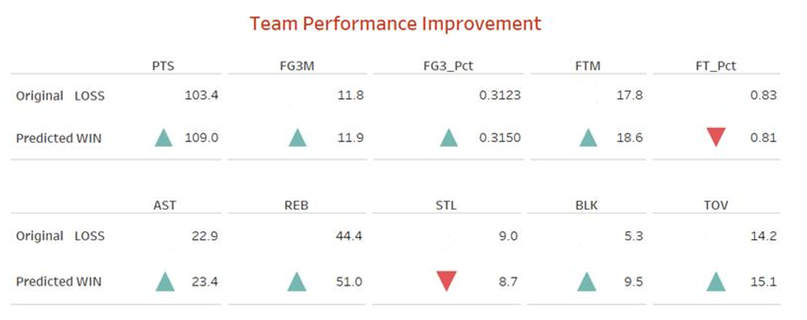
Results
Notes:
[NEXT SLIDE]

Slide 11
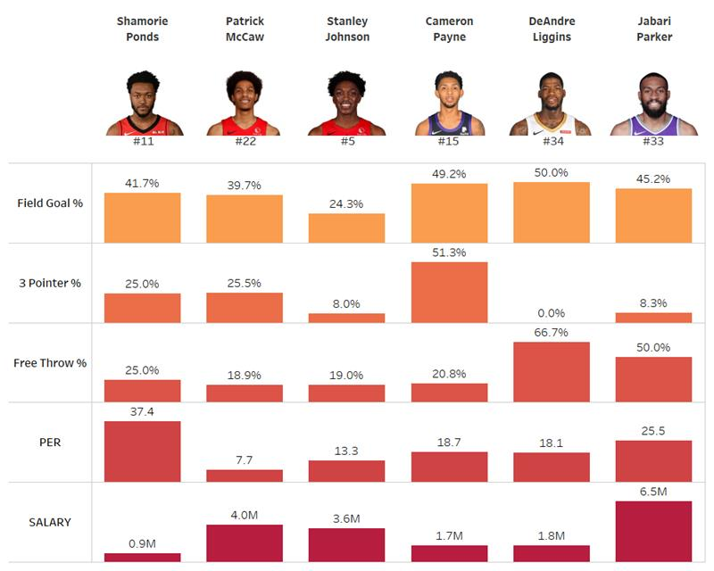
Recommendations
For improvements to the TOR roster, the organization is to look at Non-TOR players with higher values in PLUS_MINUS, PER, and PIE compared to their current roster. These statistics hold potential values in producing team wins and are underutilized by their current teams.​
Alternatively, Field Goal % (FG_PCT) and 3-pointers % (FG3_PCT) are to look out for player efficiency.
We recommend players with higher important feature values than the average TOR player and a salary below the average of a TOR player.
Notes:
For our analysis we compared the performance of these 3 models (Decision Tree, Random Forest, Logistic Regression) to 4 metrics:
[NEXT 01 - show graph]
Accuracy – How well the model make True predictions
F1-Score - How well the model make Negative predictions
Sensitivity - The test of confirming True Positives.
Specificity – The test of confirming True Negatives
When comparing the 3 different models, it was a coin toss between Random Forest and Logistic Regression . The metrics of each model were quite similar for
[NEXT 02 – Focus on accuracy and F1 scores]
Accuracy (71.9% vs 72.8%) and F1 scores (74.7% vs 74.1%). The separate was much more noticeable for
[NEXT 03 – Focus on other 2 ]
Sensitivity (61.9% vs 69%) and Specificity (81.7% vs 76.6%).
[NEXT SLIDE]

Slide 12

THANK YOU
Notes:
This concludes our interim progress presentation.
Are there any questions?
Are there any ideas or suggestions?

Slide 13
BLANK Delete everything from this slide onwards

Slide 14
[Template - Insert Title]
Notes:
[name to take over,]
Thank you, [Insert name]. Hello all, this is [Insert name]. I will continue to talk about [Insert next subject].
Thank you [Insert name]. I will continue on to the next part of [Insert next subject].
[NEXT 0x – key statement for animation]
[Speaker’s talking points on the current slide item]
[Next speak handoff statement]
Now I shall hand off to [Insert name]
[NEXT SLIDE]

